Slide 1


Can’tCode
Dr. Babasaheb Ambedkar Technological University’s
Institute of Petrochemical Engineering, Lonere-Raigad
2021-22
FINAL YEAR PROJECT
of Diploma in Computer Engineering
PROJECT PRESENTATION
A web-based Coding Platform for Aspiring Students!
Notes:
CHINMAY

Slide 2

to
Can’tCode | Introduction
Introduction
Can’tCode

Slide 3
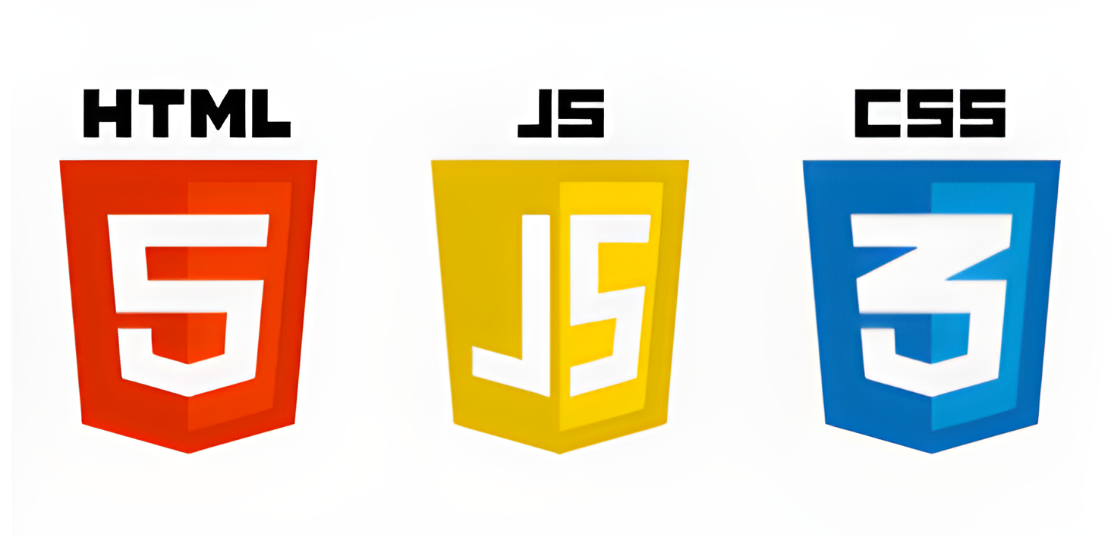

NicePage
Can’tCode | Languages & Tools
FRONT-END | Languages & Tools

Slide 4




Python
Can’tCode | Languages & Tools
BACK-END | Languages & Tools

Slide 5
Problem Statement
Can’tCode | Problem Statement
Since COVID-19 struck, It was observed that students started to lose their interest in coding practices as all educational institutions were shut down & students lost access to the labs & related resources consequently losing their motivation
Notes:
Since COVID-19 struck, It was observed that students started to lose their interest in coding practices as all educational institutions were shut down & students lost access to the labs & related resources consequently losing their motivation

Slide 6
Relevance
Can’tCode | Relevance
“PRACTICE MAKES ANYONE PERFECT”
Skills
Practical
Career
‘Can’tCode’

Slide 7
Scope
Can’tCode | Scope
Portability
Regularity
Free of Cost
Can be used by students as well as Institutes.
Notes:
As it is a web based platform, it can be accessed anytime and from anywhere.
Students can practice on a regular basis.
Our platform doesn’t charge for anything
This platform can be used by students as well as Institutes and Universities to

Slide 8
Can’tCode | Objectives
Objectives
Student Oriented
User Friendly Interface
Develop problem-solving and Logical Thinking
Gain programming skills

Slide 9
Can’tCode | User Interface
Can’t Code website
User-Interface

Slide 10
Conclusion
Can’tCode
Notes:
This came to the conclusion that, we really need to develop a student oriented coding platform. And we are still in the designing phase of our project. And by side we are also learning to improve our project as much as possible. And we assure you ma’am that we would do our best to make this project more interactive. Thank you!

Slide 11
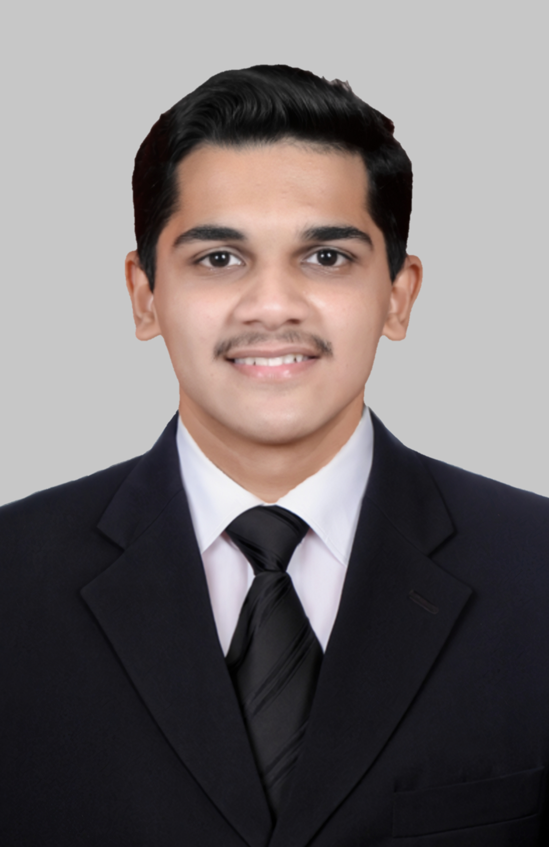
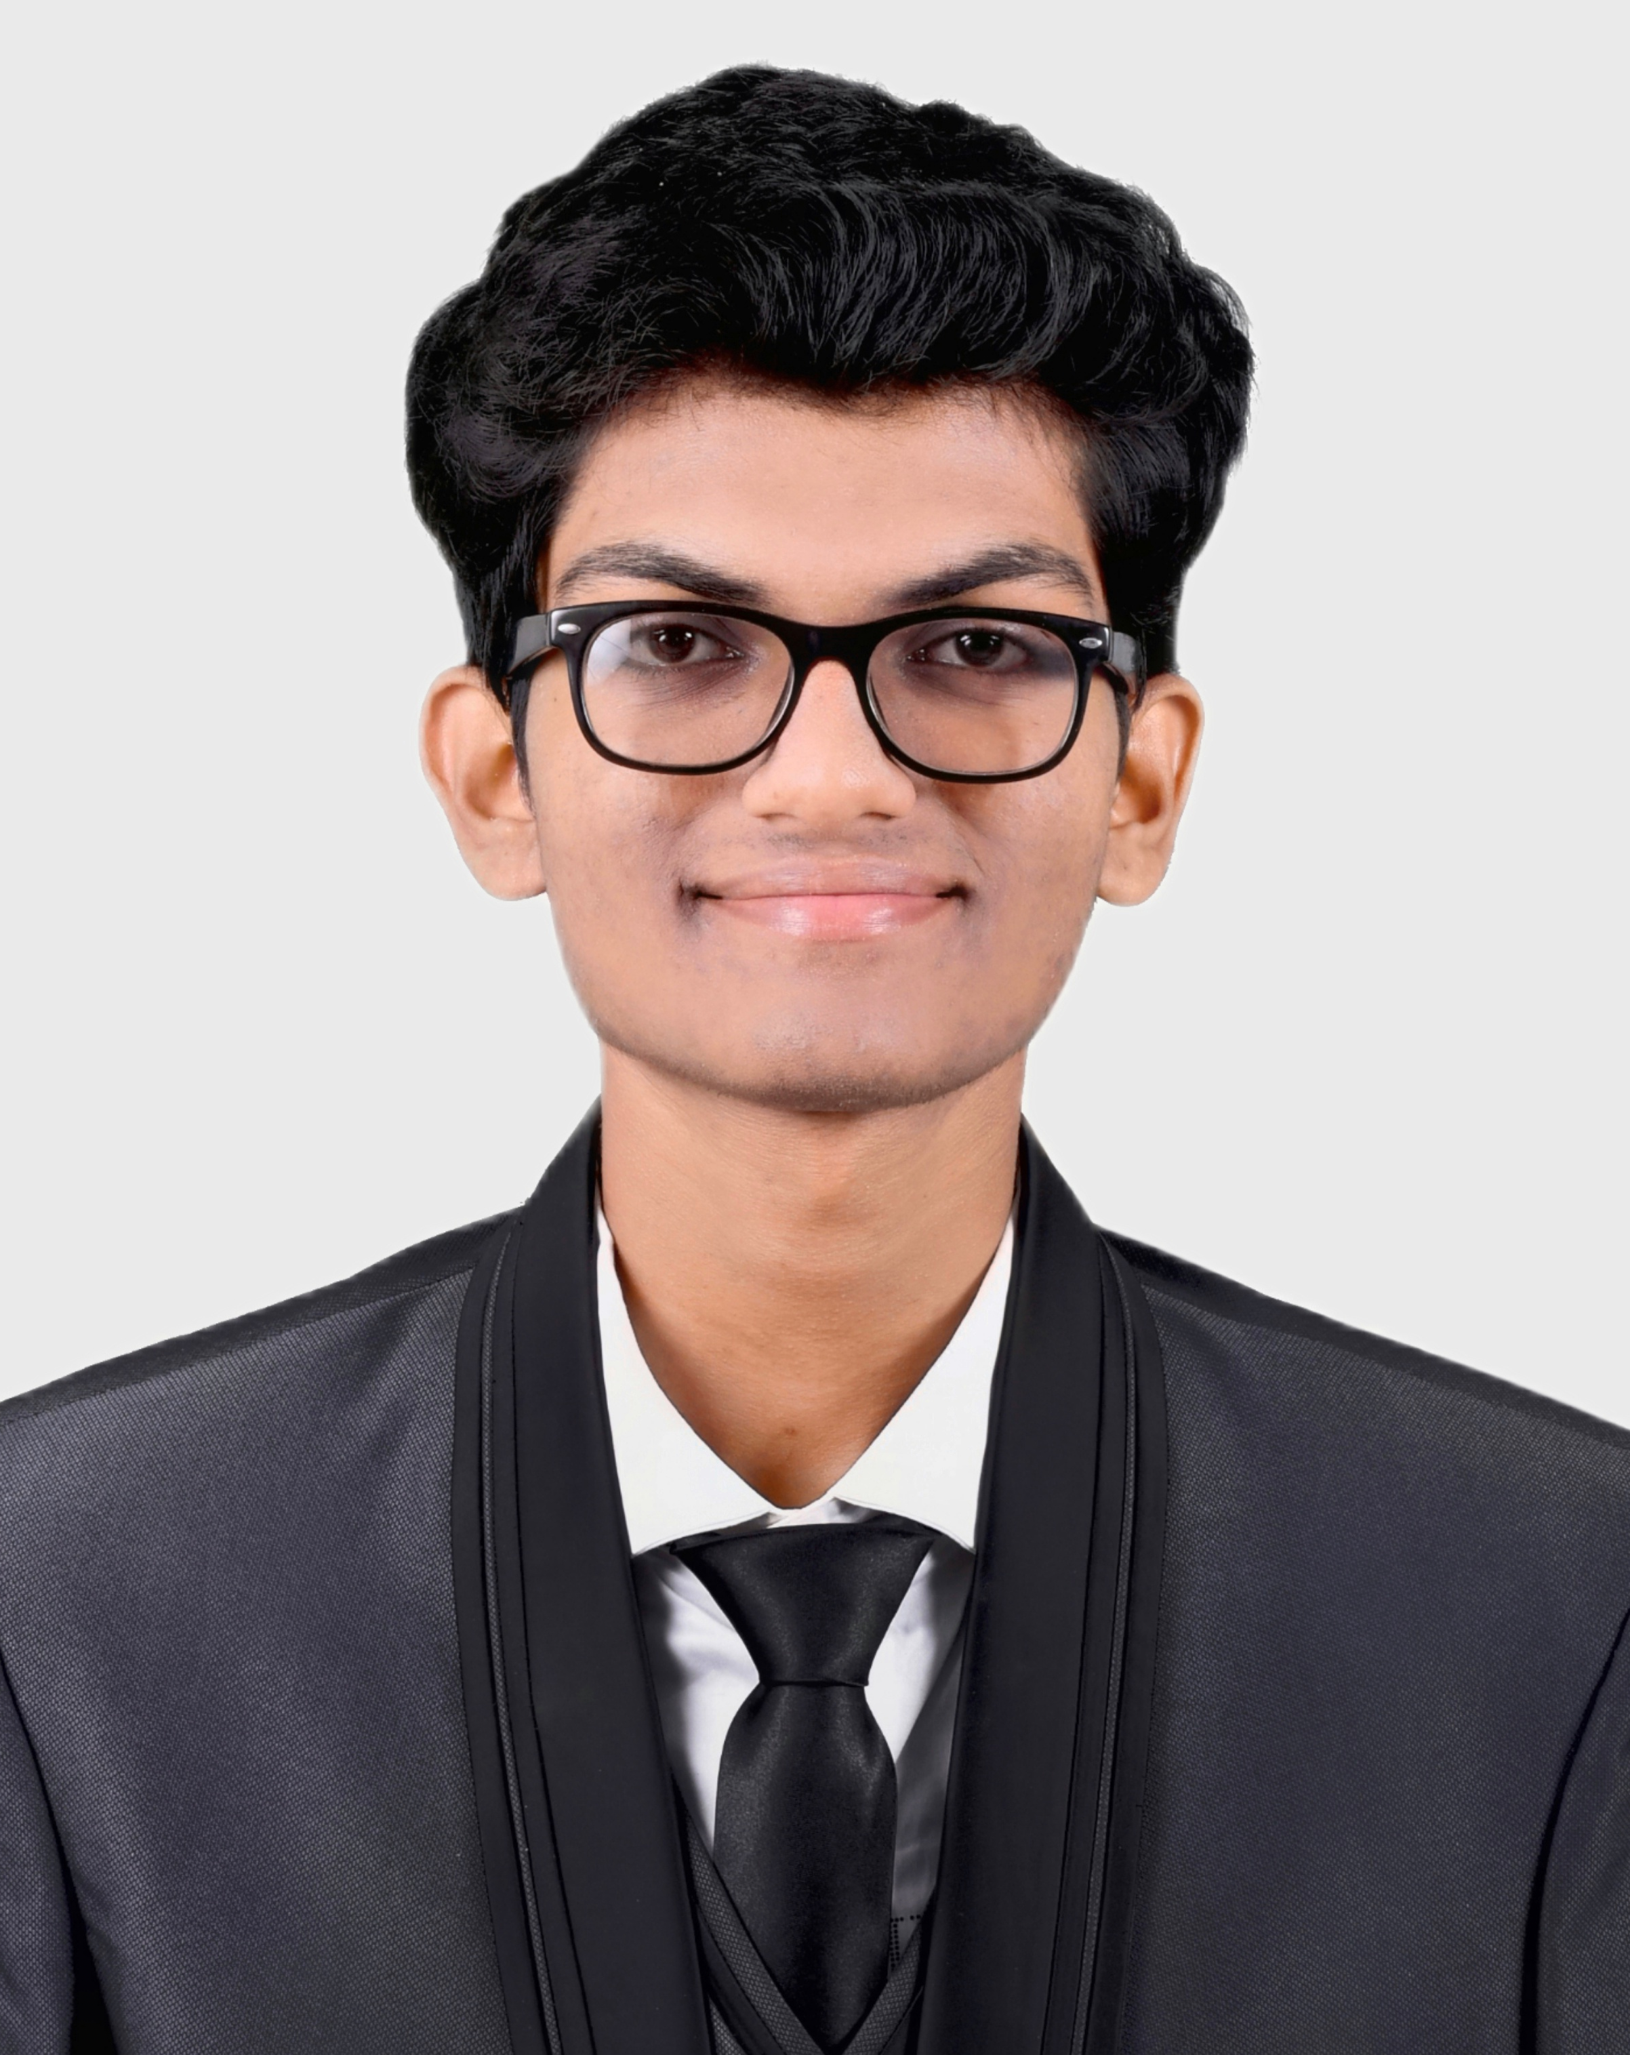
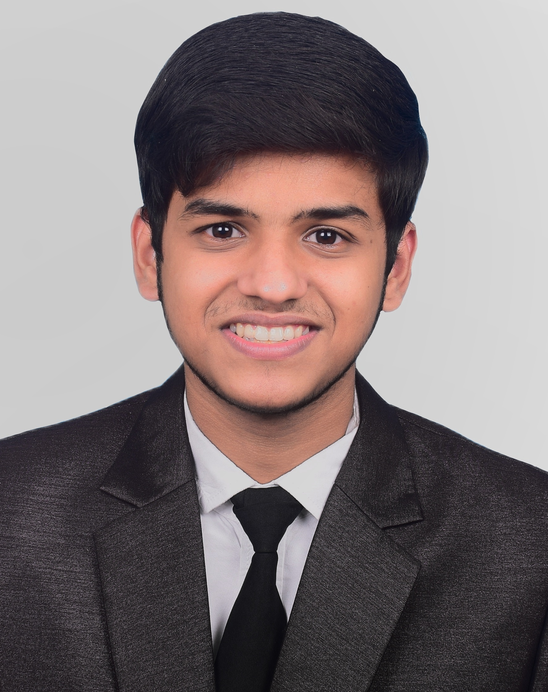
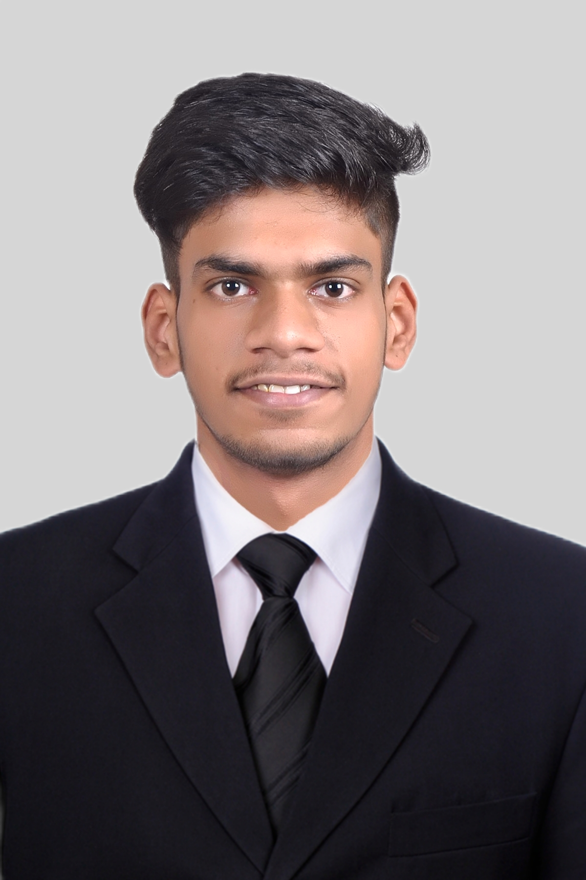
Thank You!
Dr. Babasaheb Ambedkar Technological University’s
Institute of Petrochemical Engineering, Lonere
Chinmay M. Sheth
(1930403245004)
Tejas A. Thakur
(1930403245044)
Guided by:
Prof. G. S. Mahamunkar
Anish M. Shet
(1930403245073)
Nishant D. Satere
(1930403245062)

